Slide 1
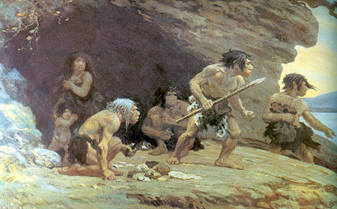
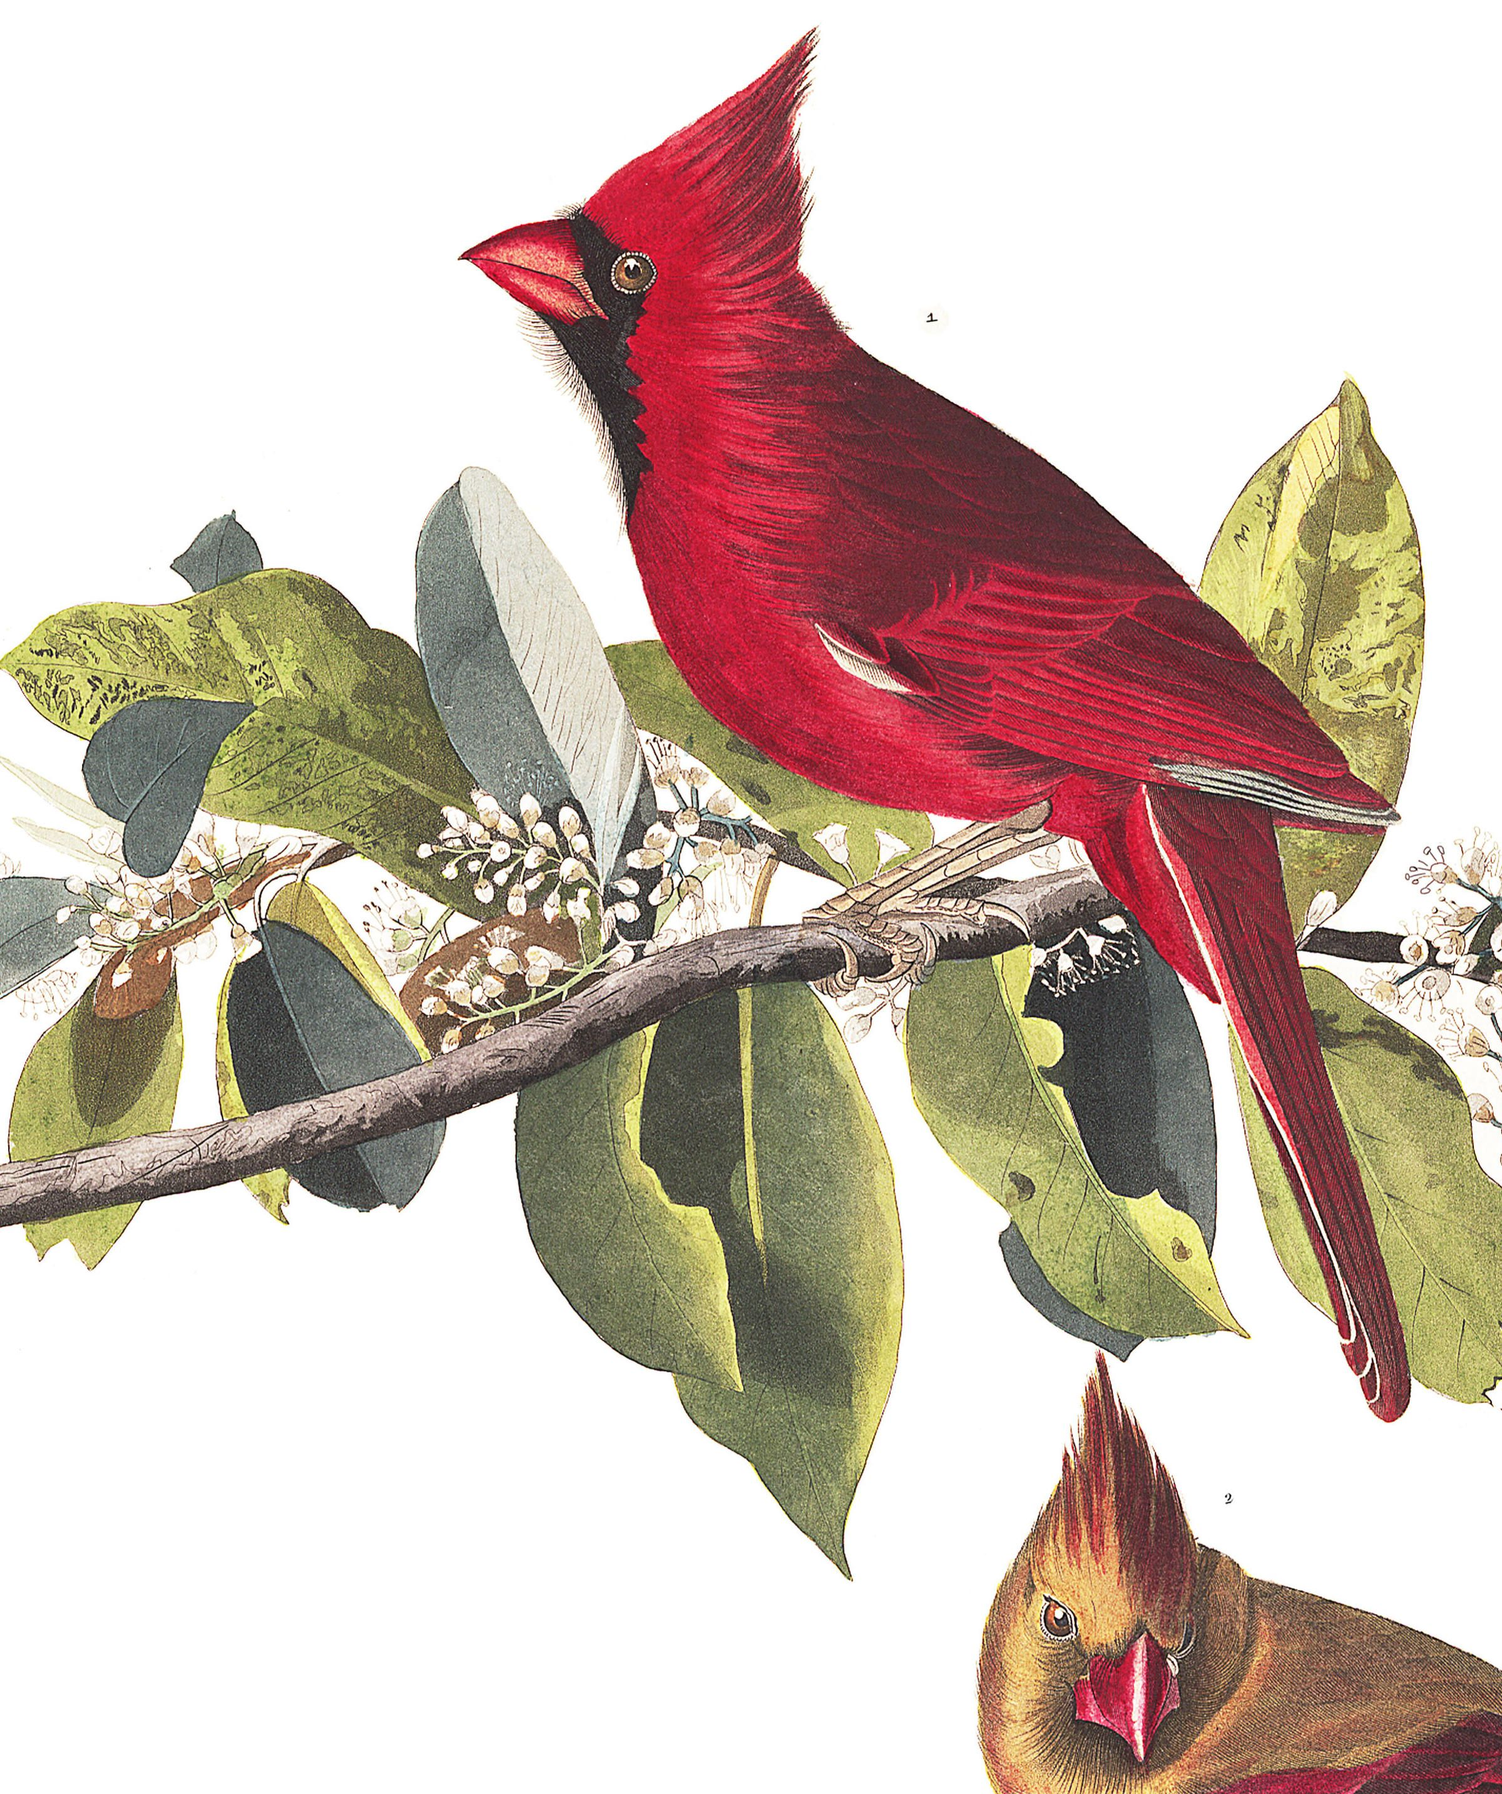
Sara E. Lipshutz, Mark S. Hibbins, Alexandra B. Bentz, Aaron M. Buechlein, Tara A. Empson, Elizabeth M. George, Mark E. Hauber, Douglas B. Rusch, Wendy M. Schelsky, Quinn K. Thomas, Samuel J. Torneo, Abbigail M. Turner, Sarah E. Wolf, Mary J. Woodruff, Matthew W. Hahn & Kimberly A. Rosvall. 2025. “Repeated behavioural evolution is associated with convergence of gene expression in cavity-nesting songbirds” Nature Ecology & Evolution. https://doi.org/10.1038/s41559-025-02675-x
Class focus area: Behavior and genomics
EEB603: Brian O’Meara
Cavity nesters (with deep apologies to Charles Knight, James Audubon, and anyone who knows cardinal nesting natural history)
All quotes and images from the above paper unless otherwise noted

Slide 2
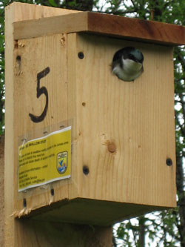
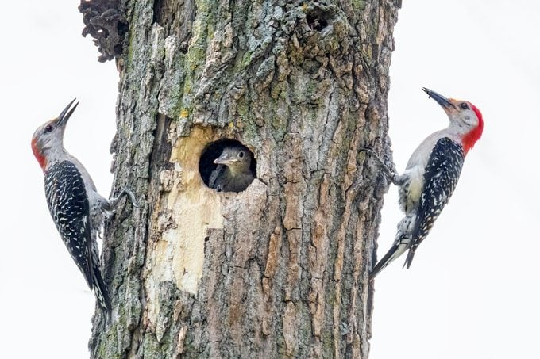
https://www.birdsandblooms.com/birding/attracting-birds/bird-nesting/birds-nest-cavities/
https://www.adfg.alaska.gov/index.cfm?adfg=livingwithbirds.birdhousetips

Slide 3
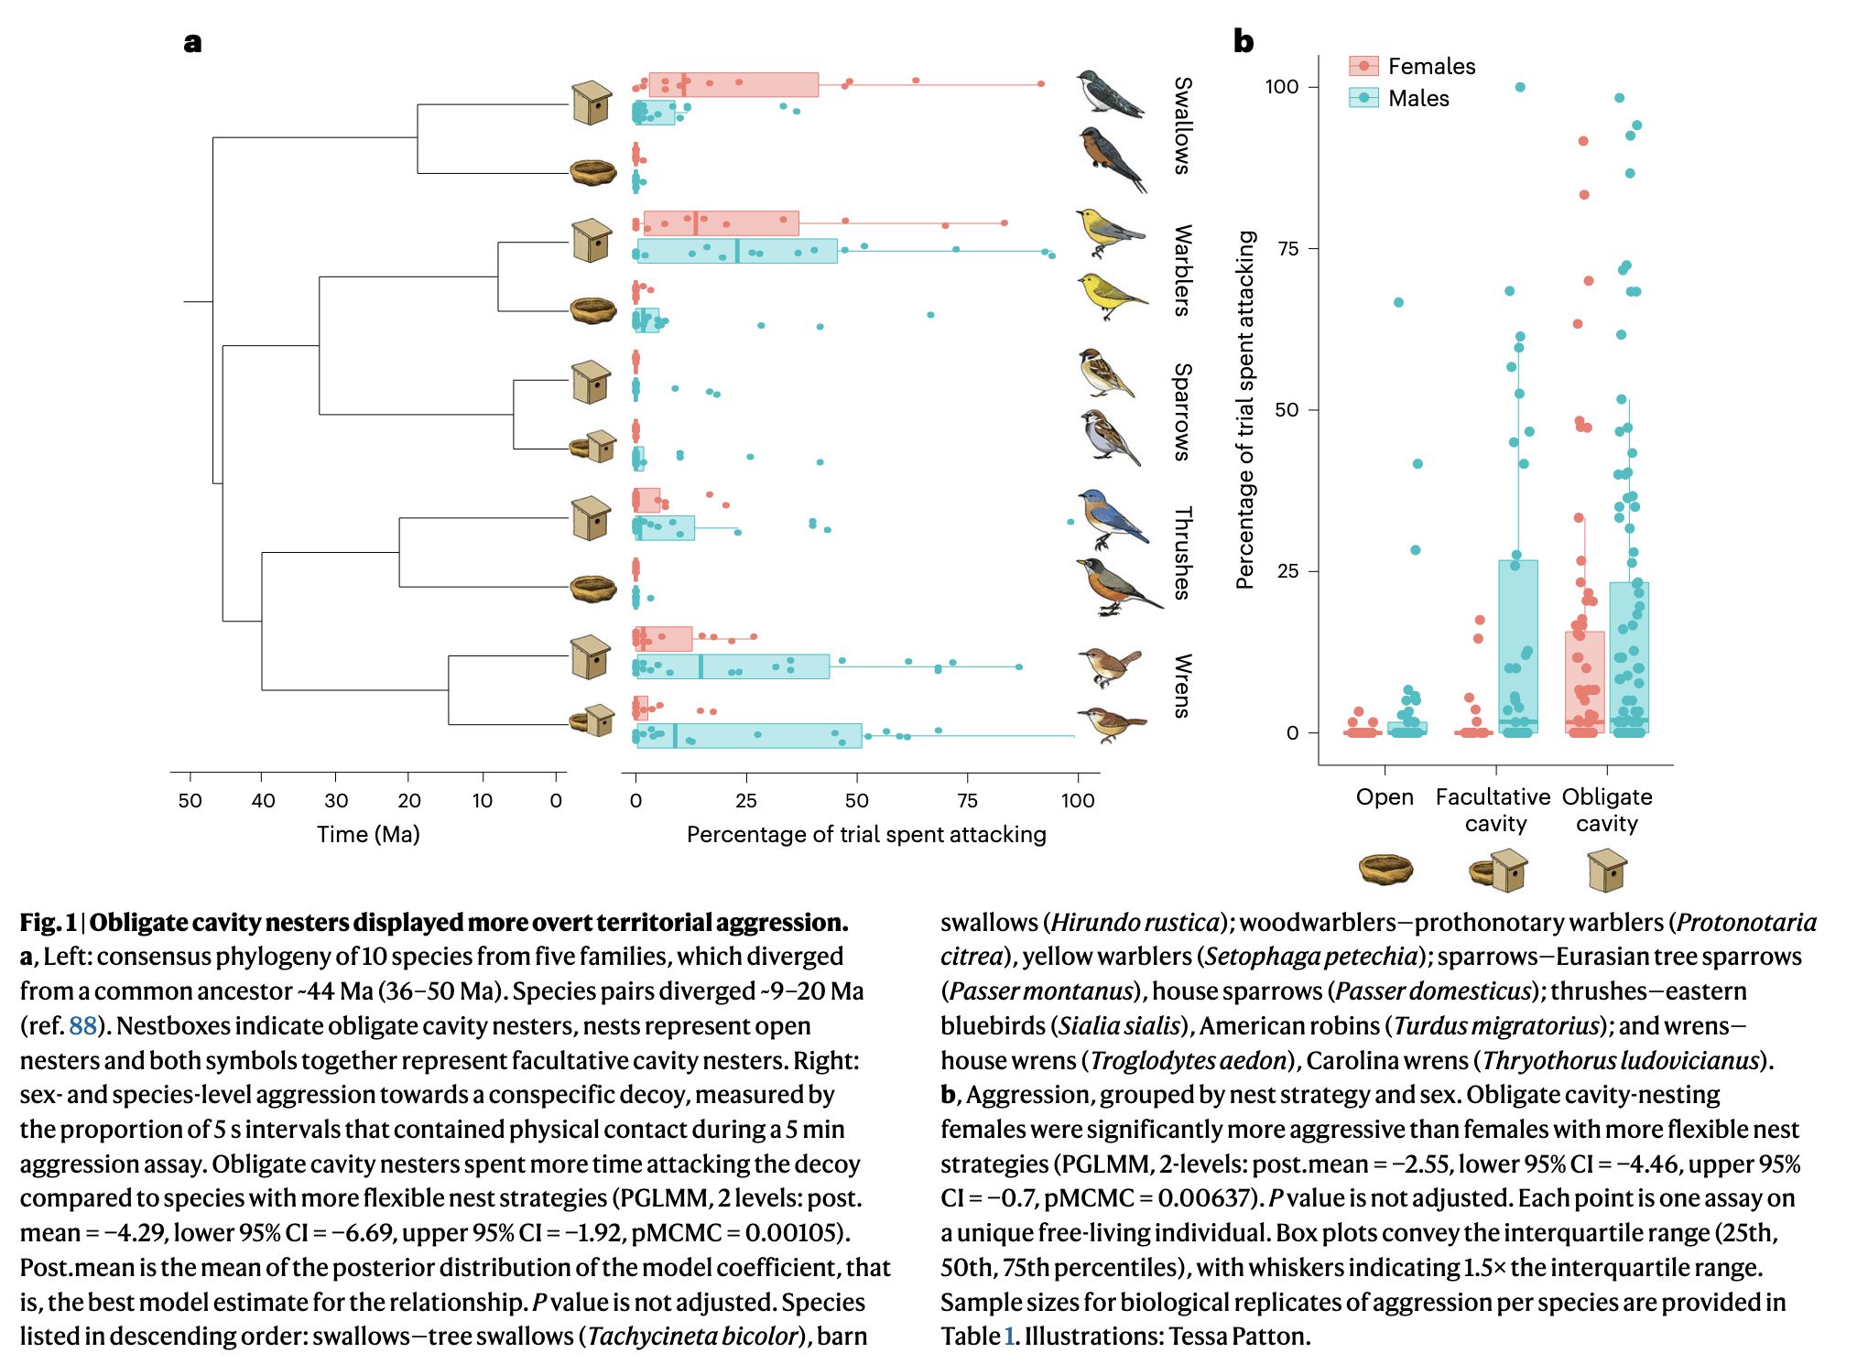

Slide 4
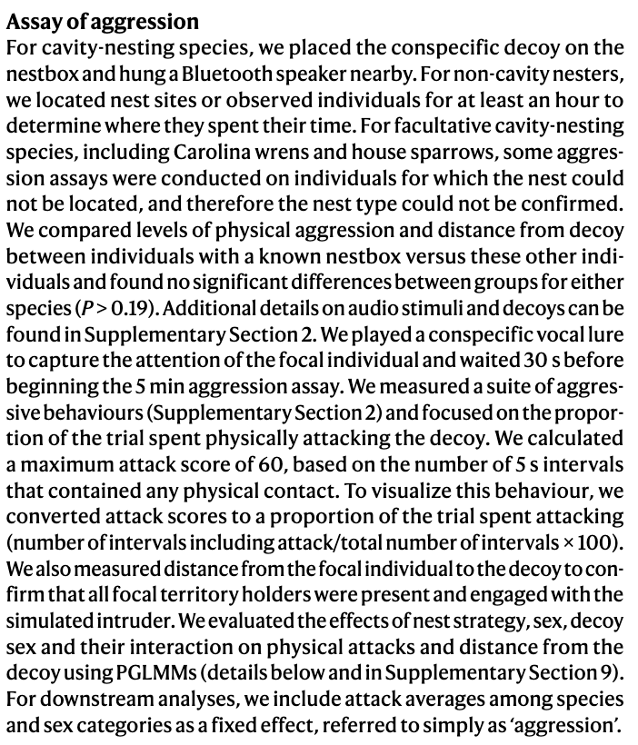

Slide 5
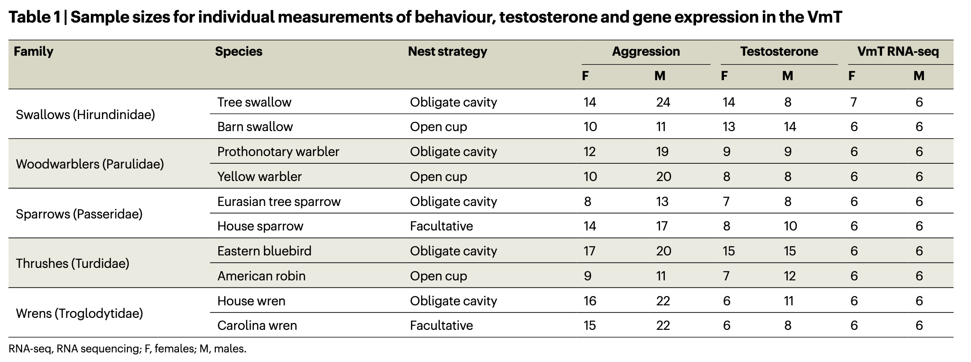

Slide 6
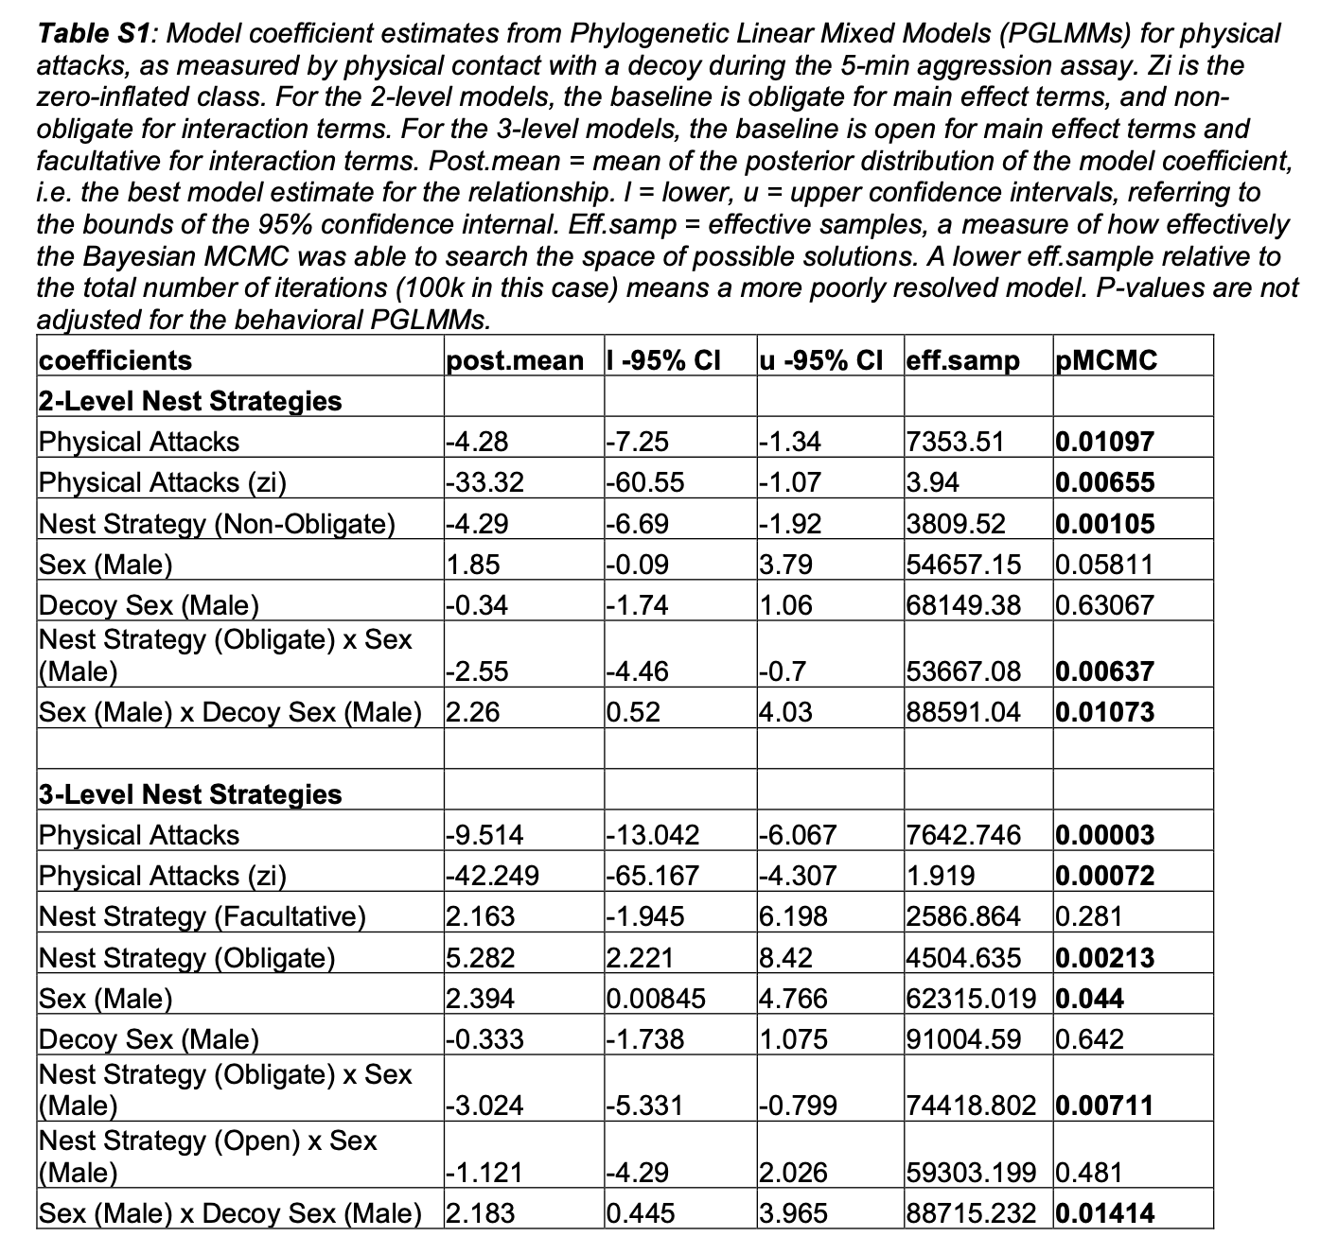

Slide 7
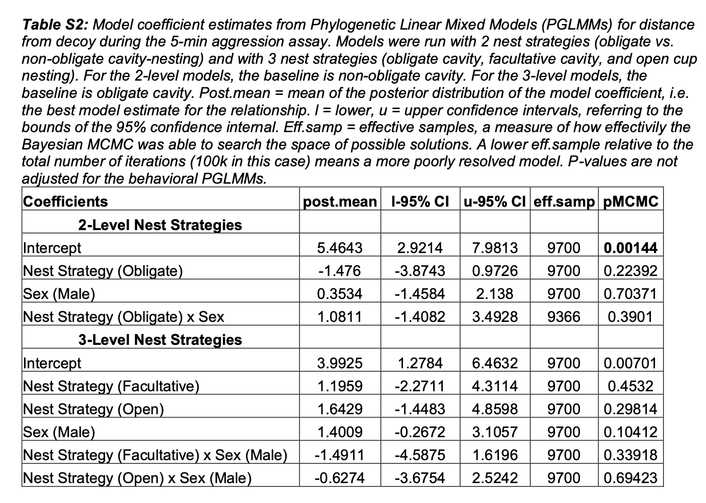

Slide 8
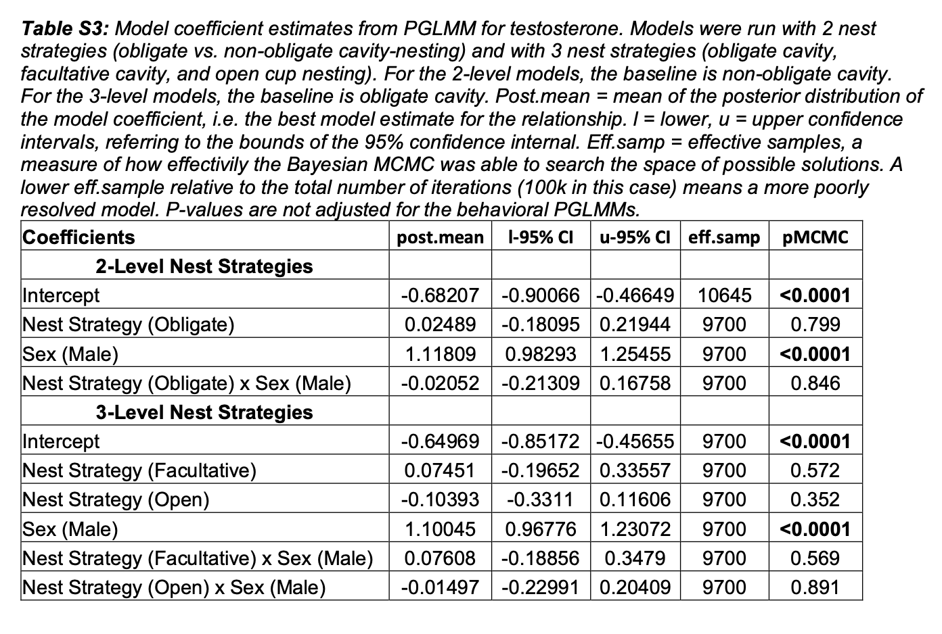

Slide 9
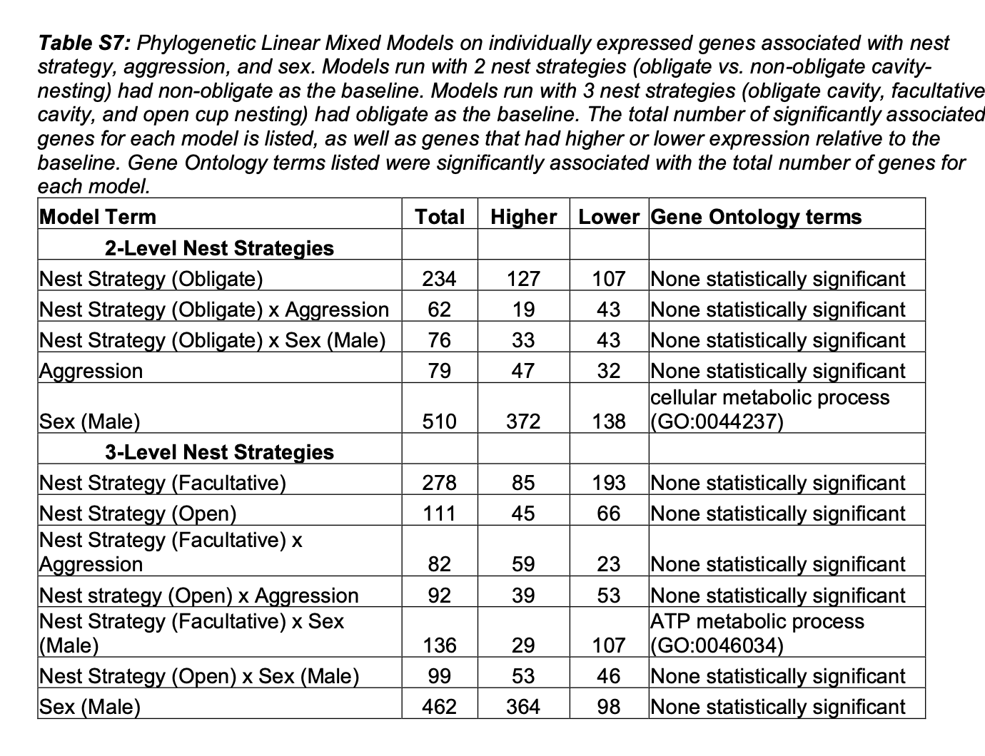

Slide 10
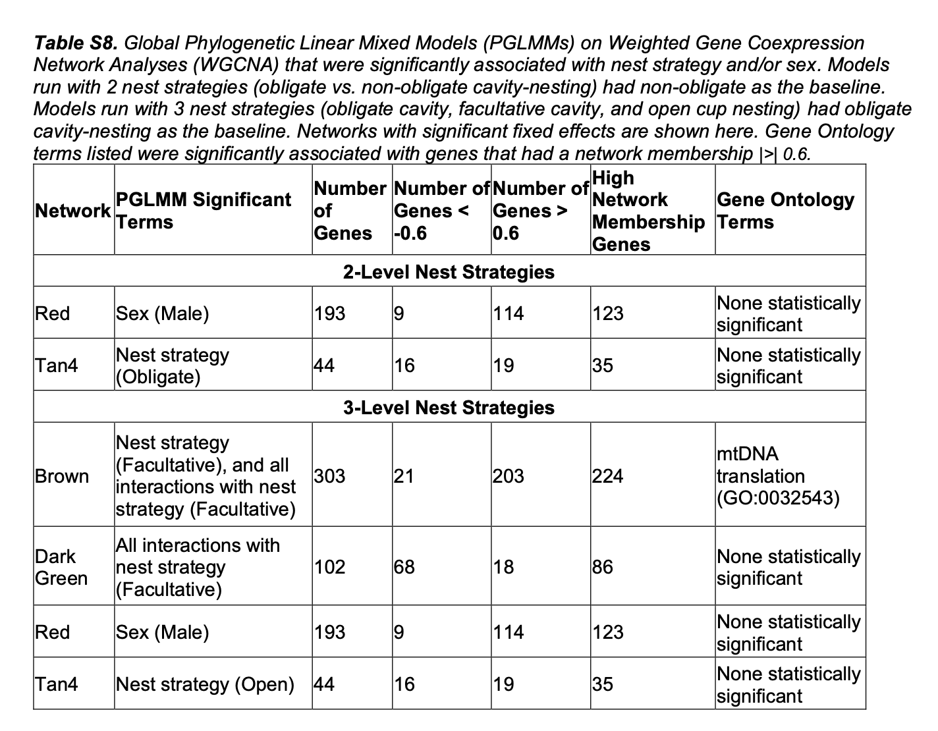

Slide 11
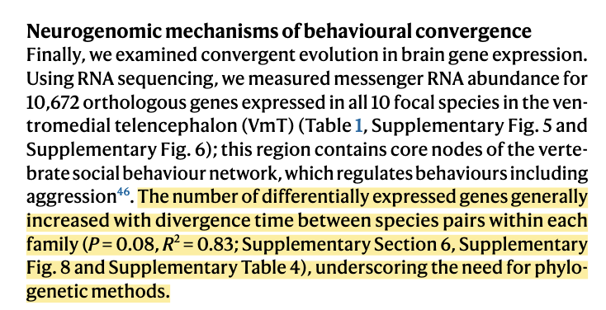
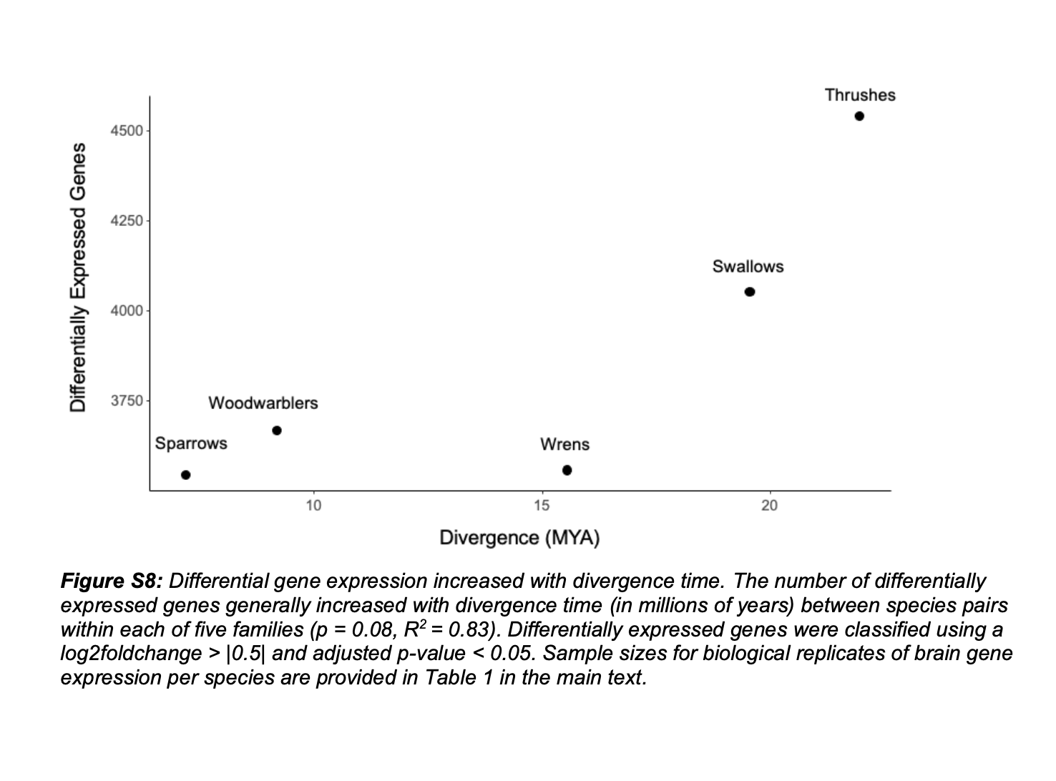
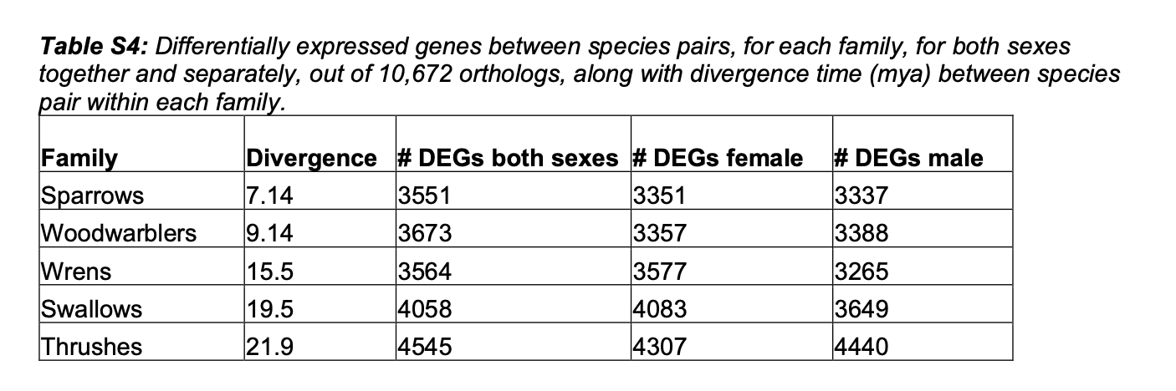

Slide 12
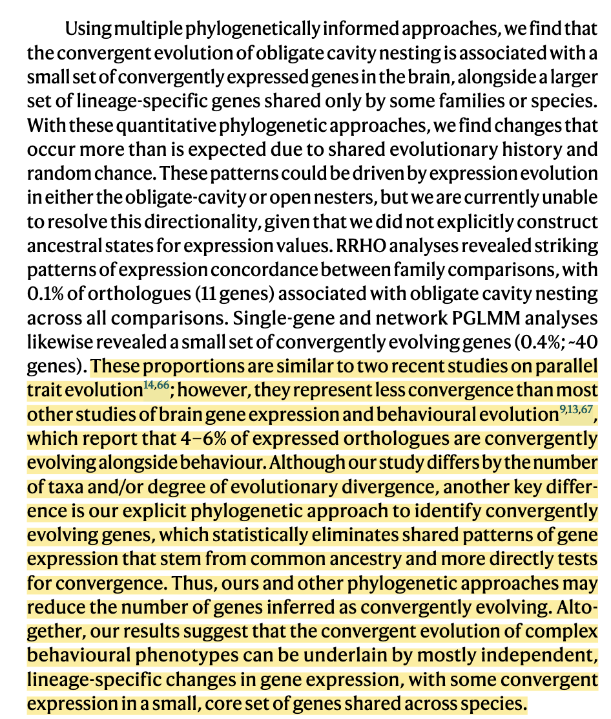

Slide 13
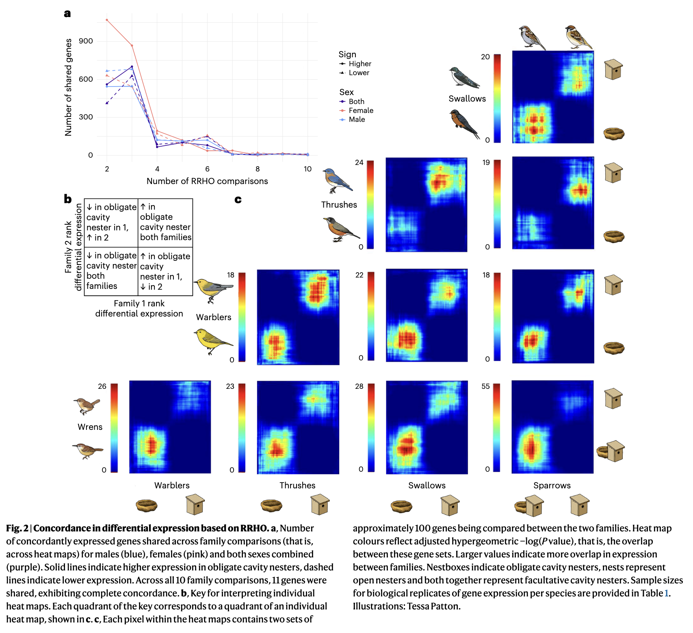

Slide 14
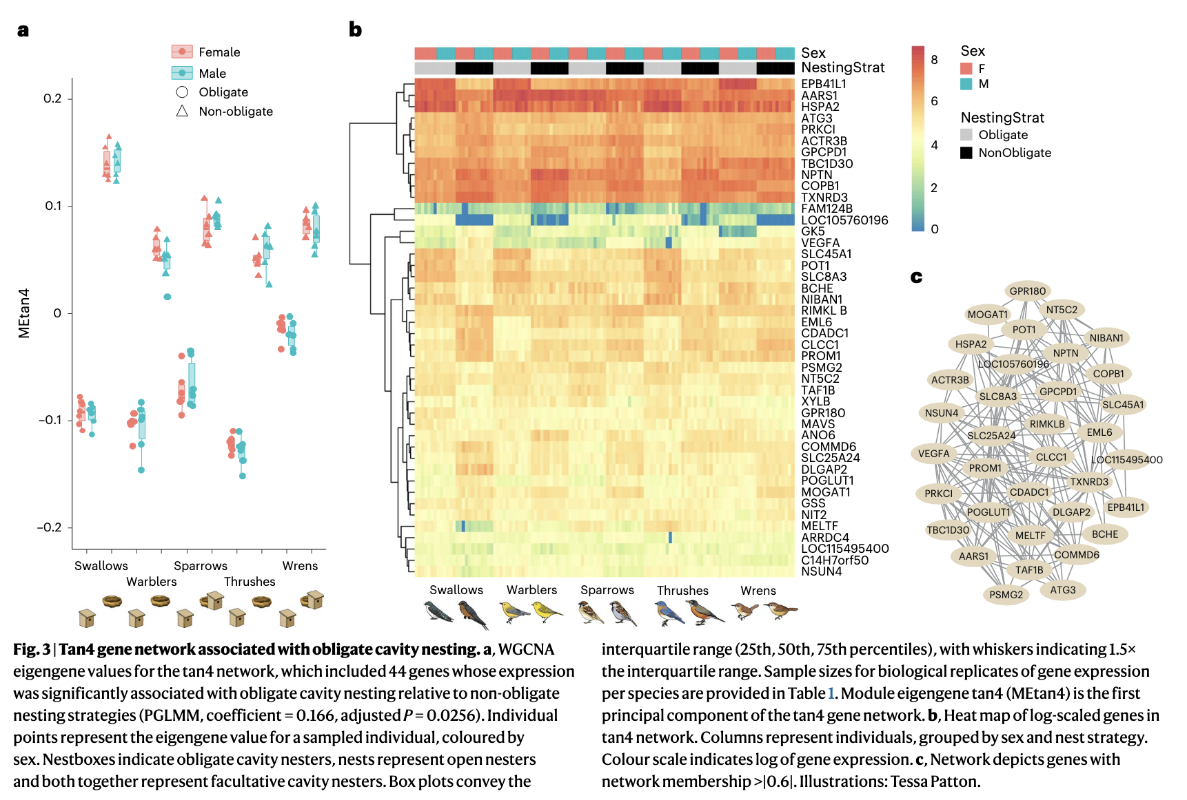

Slide 15
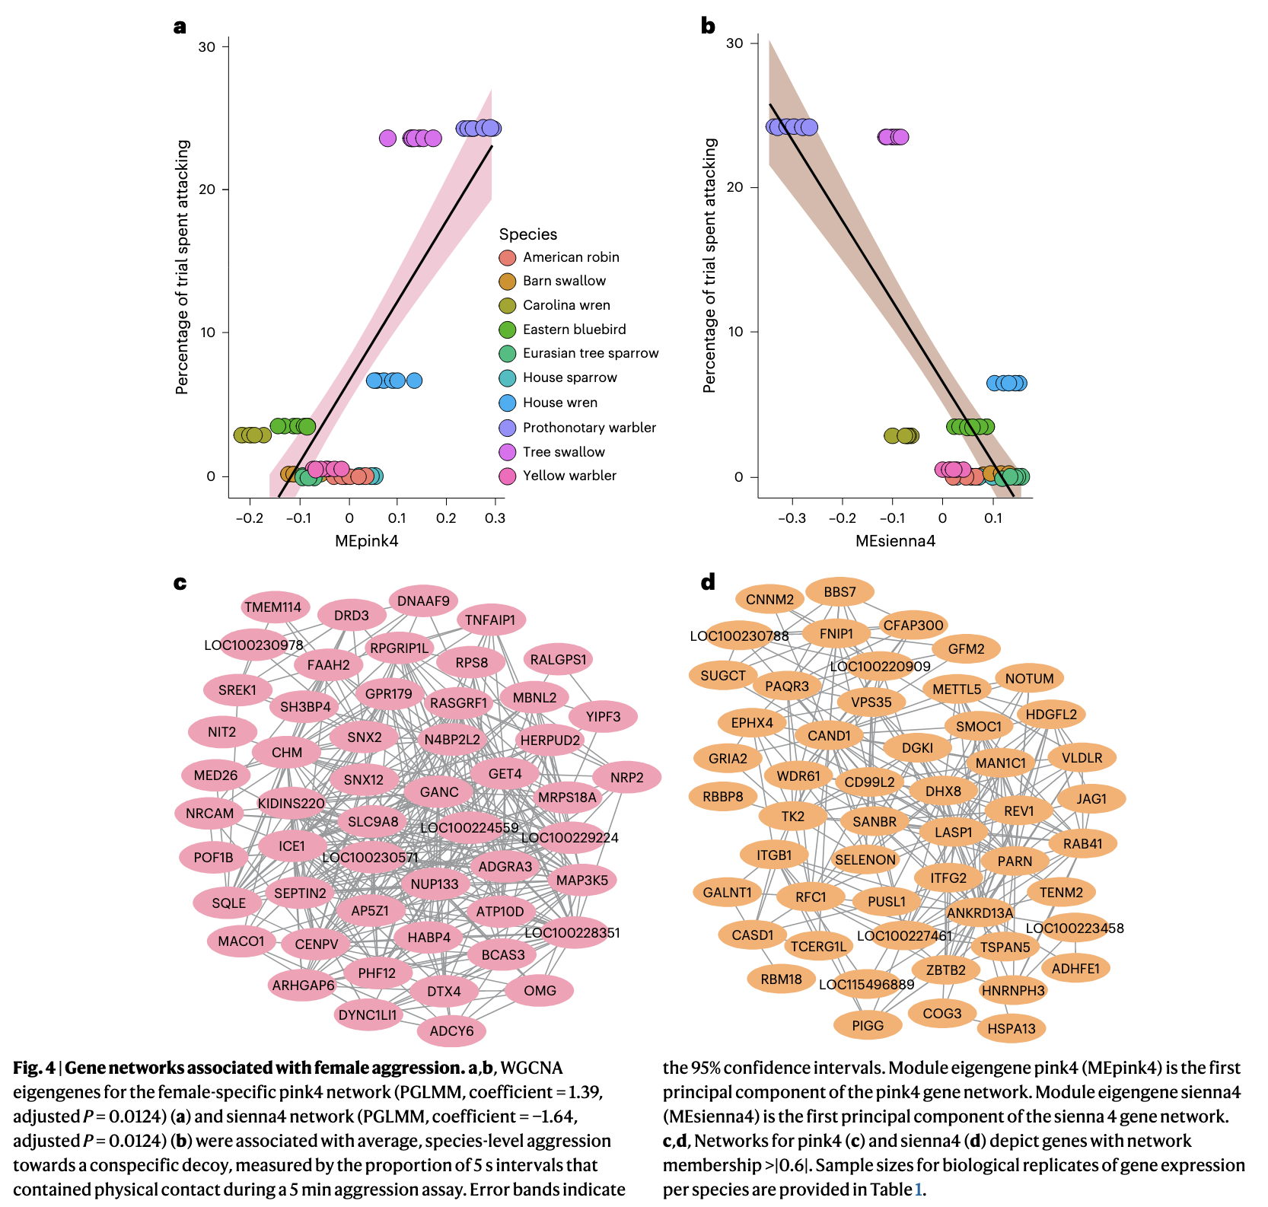

Slide 16
How to convert glorious, messy behavior into something one can analyze?
Why the use of pairs of species?
PGLMM?
Is this Bayesian?

